Slide 1
Emma Kosmin
Programme Manager
Living Wage Foundation

Slide 2
Living Wage Foundation
The Living Wage Foundation recognises and celebrates the leadership shown by Living Wage Employers across the UK.
Accreditation - Recognition through the Living Wage employer mark. Also run a Service Provider Recognition Scheme for those providing staff in lowest pay sectors.
Intelligence – Advice and support on how to implement the Living Wage.
Influence – Public forum to support the Living Wage including Living Wage Week each November.

Slide 3
Our Principal Partners

Slide 4
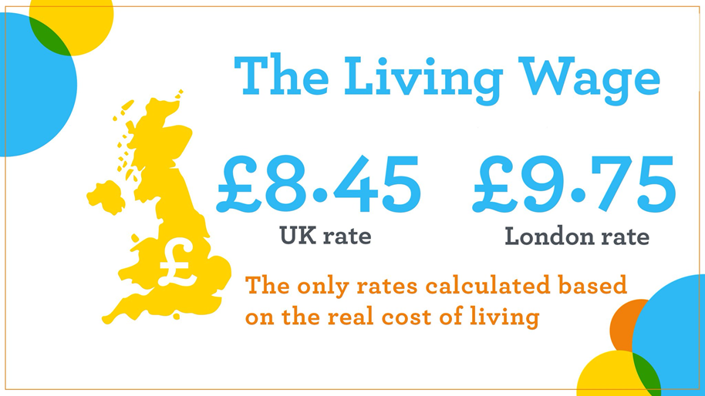
What is the Living Wage?
Hourly rate independently-calculated each year based on what employees and their families need to live
Takes into account a basket of goods and services – based on Minimum Income Standards

Slide 5
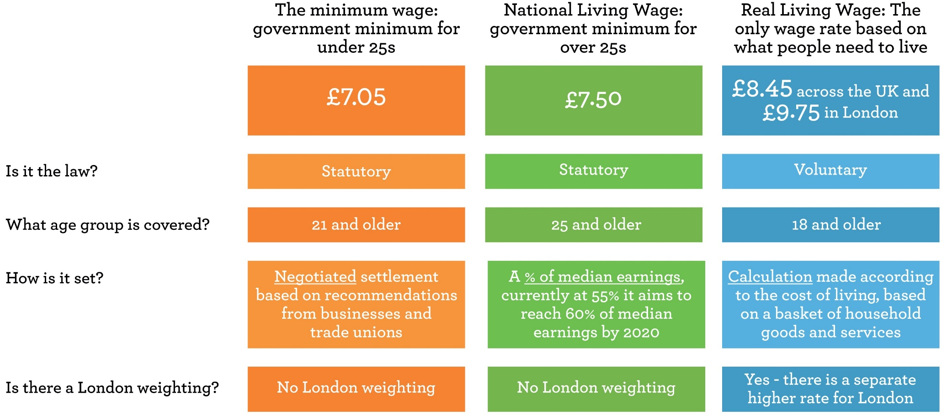
The real Living Wage

Slide 6
What is Living Wage accreditation?
Mark of a responsible employer
Accredited Living Wage employers commit to:
pay all directly employed staff the Living Wage
having a plan in place to roll the Living Wage out across third party contracts as they come up for renewal, usually over 2-3 years
The Living Wage applies to people who deliver services on the premises e.g. catering, cleaning, security

Slide 7
Our employers

Slide 8
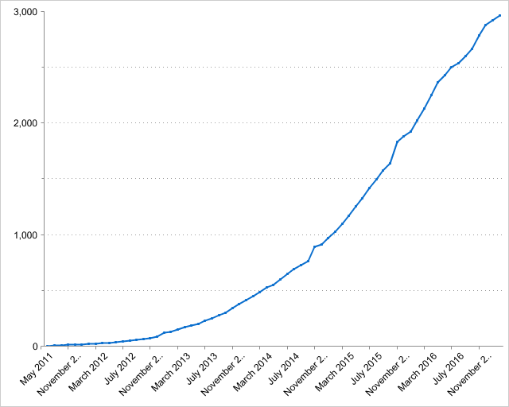
Living Wage Growth
Over 3,300 employers
Over 150,000 staff uplifted
30% FTSE 100
Breakthroughs in low paying sectors: IKEA, Oliver Bonas, Majestic Wine
Doubled since NLW announced
85 Local Authorities accredited in the UK

Slide 9
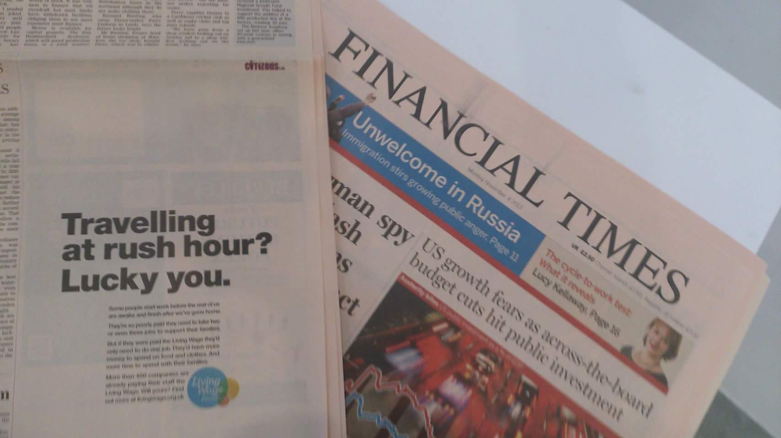
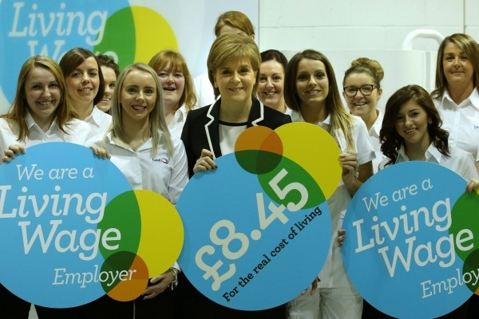
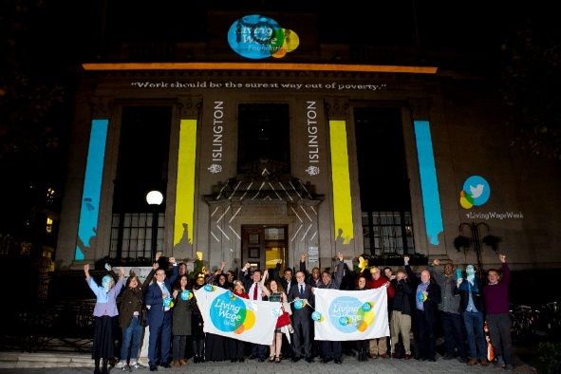
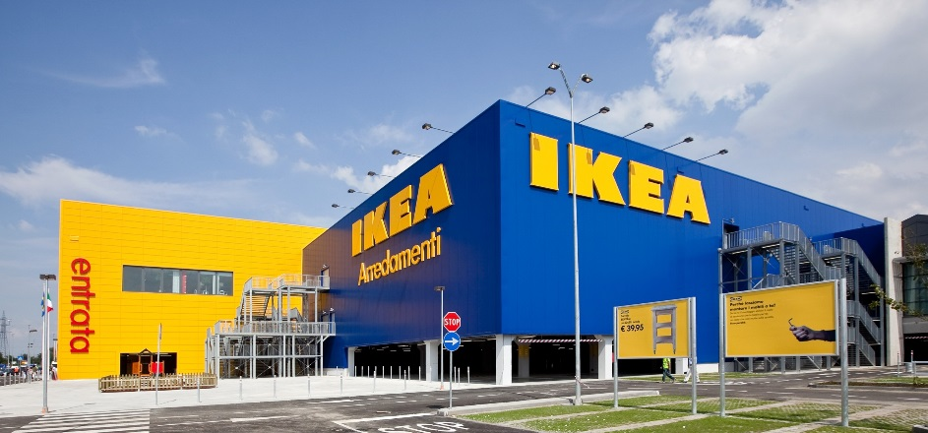
Procurement UK wide

Slide 10
Why Accreditation Matters
Long term commitment to the rates
Accredited employers uprate each year, ensuring all workers will always earn the Living Wage
They get the Employer Mark which gives consumers, users and clients a clear sign of their status as a responsible employer
It builds our movement, demonstrates leadership and encourages other employers to get on board and sign up

Slide 11
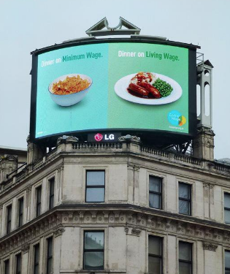
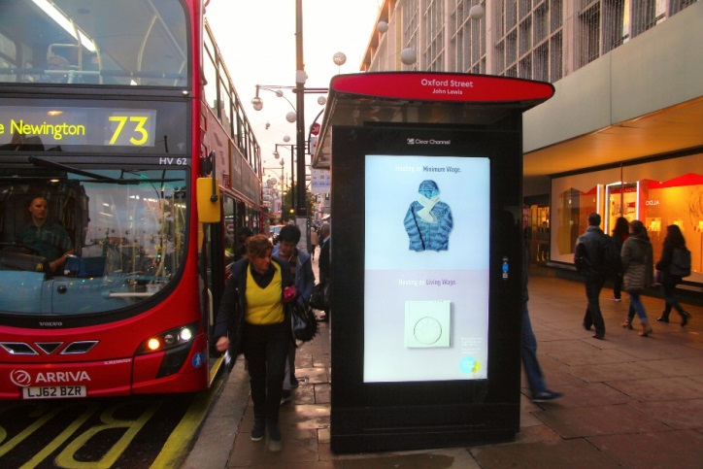
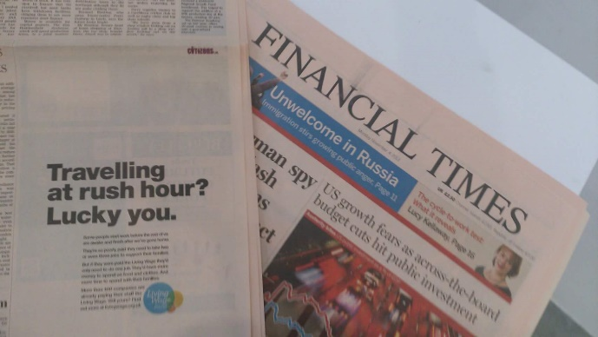
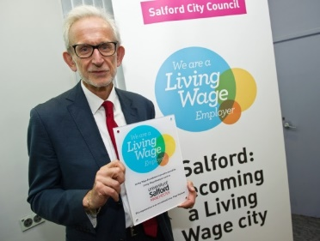
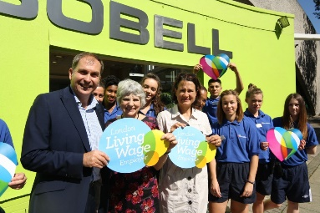
Living Wage Week
Notes:
Biggest celebration of the year.
Announcement of the rate, all employers have asap and until May as a deadline to implement this directly & in supply chains
Living Wage Week Steering Group of key employers organise how to use their resources, contacts and networks ahead of the week to galvanise the network and examples are shown above with promotion on bus stops, Piccadilly circus and FT.
This year we are focusing on promoting the logo publicly and encouraging employers to hold events (not just to award / celebrate the employers that pay it). We’re calling out to organisations to use it as a recruitment week to share their knowledge to their shared building, local community, business community, supply chain or industry. Lots of our employers proactively organise business breakfasts, write blogs or publish articles as leaders in their area.
We support all of our employers with digital media packs and resources to help amplify the messages at the time.
We look to employers and employee testimony for UK wide media support throughout the week!

Slide 12
Business benefits
93% of employers reported they had gained as an organisation after becoming a real Living Wage employer
76% of large Living Wage employers reported improved retention
64% of accredited organisations felt that accreditation differentiated them from others in the same industry
80% of employers felt that the Living Wage had increased consumer awareness of their commitment to be an ethical employer
7 out of 10 of consumers said they would consciously shop in favour of a Living Wage accredited retail chain

Slide 13
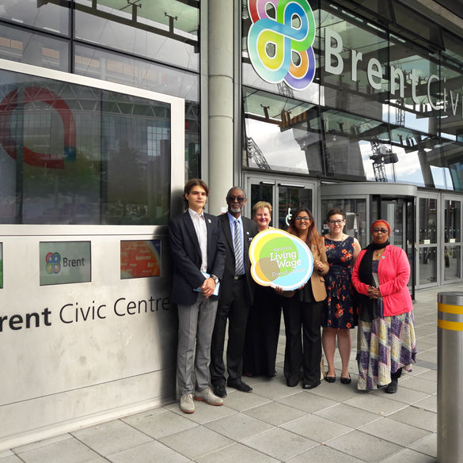
Living Wage and Local Authorities
We work with a range of Councils to promote the Living Wage across towns and cities, through:
Targeted outreach
Business engagement / networking events
Business Rates schemes
Living Wage Friendly Funder scheme
Celebrating Living Wage Week
Announcing new employers going LW

Slide 14
Thank you
Please contact:
Emma Kosmin
Programme Manager Living Wage Foundation 020 7043 9882 emma.kosmin@livingwage.org.uk
@LivingWageUK

